Slide 1


From Votes to Value : Restaurant Analytics Minor Project Presentation
DEPARTMENT OF DATA SCIENCE
PRESENTED BY:
FATHIMA - 18

Slide 2
Introduction
In today’s data-driven environment, analytics and machine learning play a vital role in understanding customer behavior and improving business outcomes. The restaurant industry, influenced by digital platforms and changing consumer preferences, offers rich opportunities for data-driven analysis. This project, “From Votes to Value: Restaurant Analytics,” examines how factors such as customer ratings, online ordering, pricing, and service types contribute to restaurant success.

Slide 3
Tools
The study begins with Exploratory Data Analysis (EDA) to uncover patterns, trends, and relationships within the data using tools such as Python and Tableau. Building on these insights, a Random Forest machine learning algorithm is applied to model and predict restaurant performance based on key features. The combined use of EDA and Random Forest highlights that restaurant success is driven by a balanced mix of affordability, service quality, popularity, and consistent customer engagement.

Slide 4
Problem Statement
Is online ordering alone enough for restaurant success?
What factors truly affect customer engagement?
The core problem, therefore, lies in identifying and interpreting the key factors—both service-related and consumer-driven—that influence the success or failure of restaurants, particularly those operating in an online-first environment. We aim to determine whether customer votes, ratings, price range, and restaurant type play a more significant role than digital convenience alone.

Slide 5
Objectives
Study impact of online ordering & table booking
Analyze cost vs ratings
Identify success factors
Build a prediction model

Slide 6
Data Collection , Data Cleaning & Transformation
Source: Kaggle
148 restaurant records
Ratings, votes, cost, service type
Converted ratings to numeric values
Created high rating feature
Removed inconsistencies

Slide 7
Exploratory Data Analysis (EDA)
Univariate: Analyzed restaurant types, ratings, and price ranges to understand customer preferences and spending patterns.
Bivariate: Compared ratings and cost to assess the impact of services like table booking.
Multivariate: Used a heatmap to examine restaurant types and online ordering behavior.
EDA revealed key trends in pricing, customer satisfaction, and service features.

Slide 8
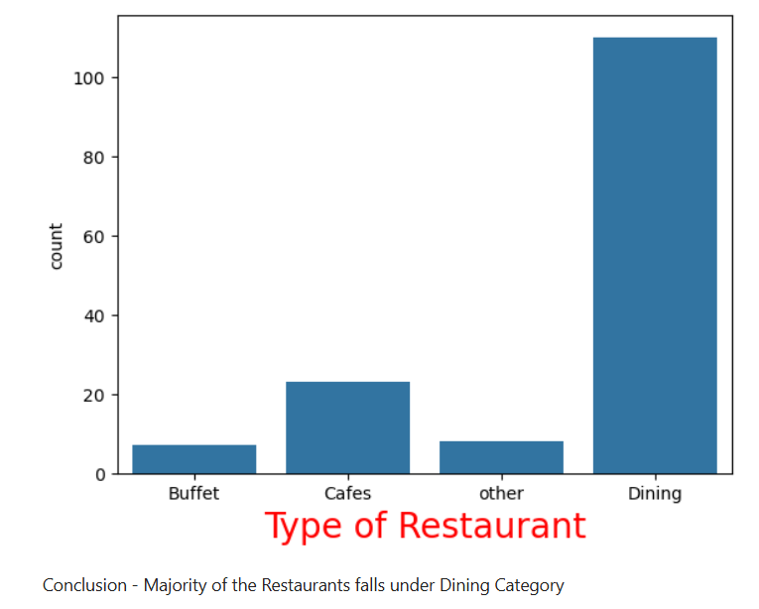
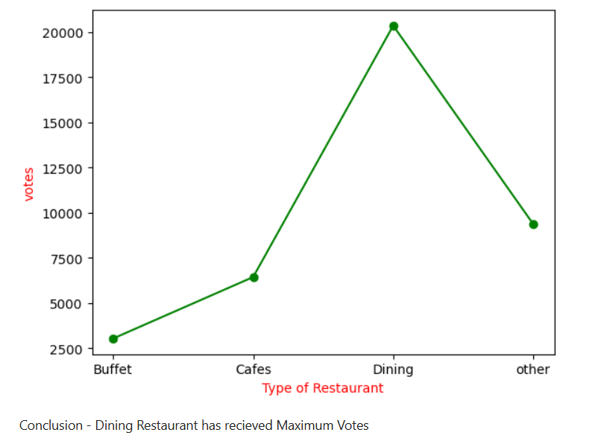
Visualization

Slide 9
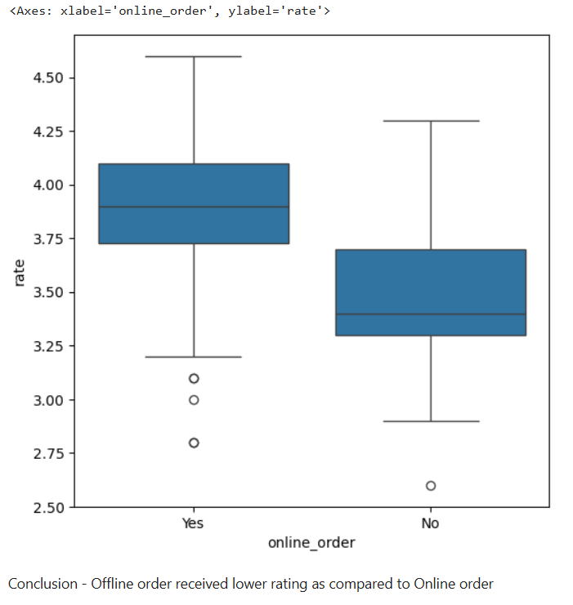
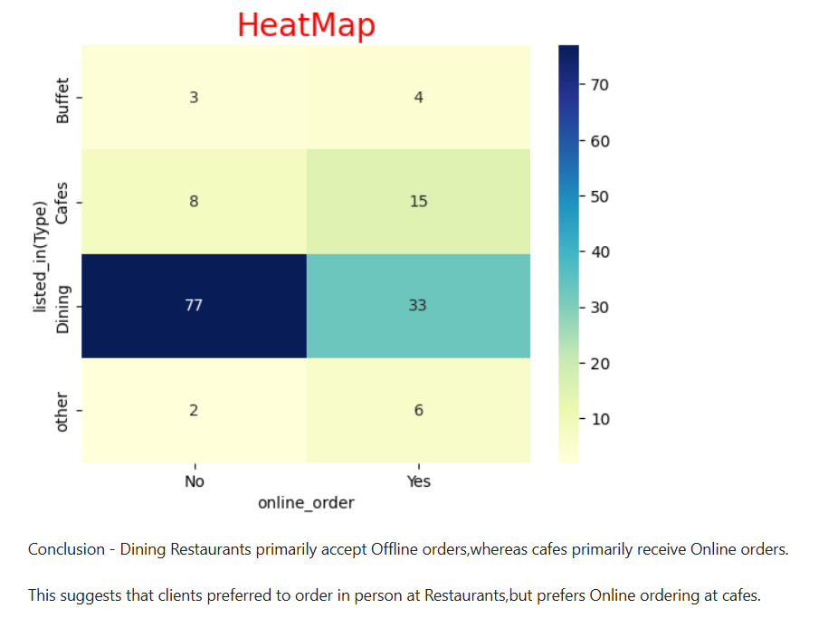

Slide 10
Predictive Modeling – Random Forest
The goal was to predict restaurant success for outlets with online ordering but no table booking.
Success was defined using a binary variable is_successful (rating > 4.0 and votes > 200).
Key features included cost for two and restaurant type, with categorical variables label-encoded.
A Random Forest Classifier was trained and evaluated using a classification report and confusion matrix.
Feature importance analysis highlighted the factors most influencing restaurant success.
This model helps identify effective pricing and service strategies that drive customer engagement.

Slide 11
Findings & Insights from the Predictive Model
Customer Engagement Strongly Influences Success
Average Cost for Two Shows Mixed Influence
Restaurant Type (listed_in(type)) Affects Success Patterns
High Rating Alone Is Not Sufficient
Feature Importance Confirms Service Strategy Relevance
Model Captured Patterns Accurately

Slide 12
Conclusion
After visualizing restaurant trends and analyzing success patterns, we built a predictive model focusing on restaurants that offer online ordering but not table booking. The results suggest that:
Most such restaurants are less likely to be successful.
The cost of dining and service type are influential factors.
Offering only online ordering may not be sufficient to ensure profitability.
Our model achieved 73% accuracy, though limited by class imbalance.

Slide 13
This project provided valuable insights into restaurant success patterns, especially for those relying solely on online ordering. Through exploratory analysis, we discovered that while online ordering is a popular service model, it does not guarantee success without complementary factors like competitive pricing, service type, and strong customer engagement.
The predictive model, achieving 73% accuracy, revealed that restaurants with higher ratings, vote counts, and aligned service types (like quick bites or delivery) are more likely to be successful. However, the analysis also highlighted challenges such as class imbalance and limited features.

Slide 14
THANK YOU

